Slide 1
Activity Recognition
Anirudh Chaudhary, Quan Le, Hao Nguyen

Slide 2

Problem Statement
Predict activities of users
University of California Irvine
Samsung Galaxy S II
30 Volunteers (19-48 years old)
6 activities
3-axial linear acceleration
3-axial angular velocity at a constant rate of 50Hz
Notes:
Context: Dataset was collected by the Center for Machine Learning and Intelligent Systems in University of California Irvine about the experiments that have been carried out with a group of 30 volunteers within an age bracket of 19-48 years. Each person performed six activities (WALKING, WALKING_UPSTAIRS, WALKING_DOWNSTAIRS, SITTING, STANDING, LAYING) wearing a smartphone (Samsung Galaxy S II) on the waist. Using its embedded accelerometer and gyroscope, we captured 3-axial linear acceleration and 3-axial angular velocity at a constant rate of 50Hz. The experiments have been video-recorded to label the data manually.
Related Business Problem: Being able to identify the activity of human beings is very crucial for smart home application. By identifying the correct current activities of app users, the smart home application can easily decide the proper activities of appliances in the house to facilitate the indoor activities. For example, if the app is able to detect if the user is walking upstairs or downstairs, it can trigger the stair light on and off accordingly.
Goal of the project: The project is to find out the best machine learning model that can predict precisely the activities of smartphone users.

Slide 3
There are 10,299 obs and 561 features.
tBodyAcc-XYZ
tGravityAcc-XYZ
tBodyAccJerk-XYZ
tBodyGyro-XYZ
tBodyGyroJerk-XYZ
tBodyAccMag
tGravityAccMag
tBodyAccJerkMag
tBodyGyroMag
tBodyGyroJerkMag
fBodyAcc-XYZ
fBodyAccJerk-XYZ
fBodyGyro-XYZ
fBodyAccMag
fBodyAccJerkMag
fBodyGyroMag
fBodyGyroJerkMag
mean(): Mean value
std(): Standard deviation
mad(): Median absolute deviation
max(): Largest value in array
min(): Smallest value in array
sma(): Signal magnitude area
energy(): Energy measure. Sum of the squares divided by the number of values.
iqr(): Interquartile range
entropy(): Signal entropy
arCoeff(): Autorregresion coefficients with Burg order equal to 4
correlation(): correlation coefficient between two signals
maxInds(): index of the frequency component with largest magnitude
meanFreq(): Weighted average of the frequency components to obtain a mean frequency
skewness(): skewness of the frequency domain signal
kurtosis(): kurtosis of the frequency domain signal
bandsEnergy(): Energy of a frequency interval within the 64 bins of the FFT of each window.
angle(): Angle between to vectors.
Notes:
Input Variables: There are four different text files in csv format to use in this project including X_train.txt, Y_train.txt, X_test.txt, Y_test.txt

Slide 4
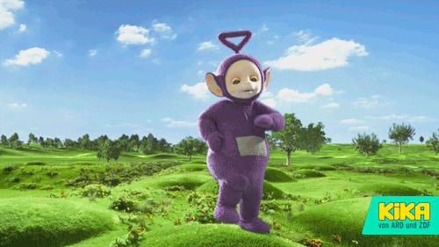
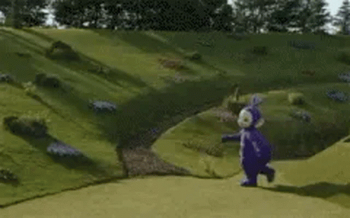
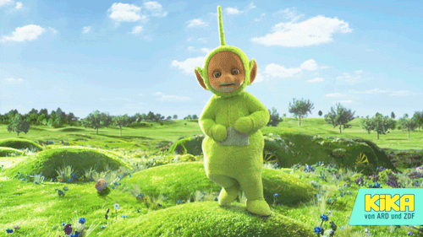
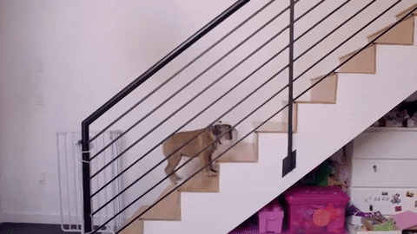


Six Activities Labels
1 | 4
2 | 5
3 | 6
Notes:
---------------------------ANIMATION SLIDE! ---------------------------
1-WALKING
2-WALKING_UPSTAIRS
3-WALKING_DOWNSTAIRS
4-SITTING
5-STANDING
6-LAYING

Slide 5
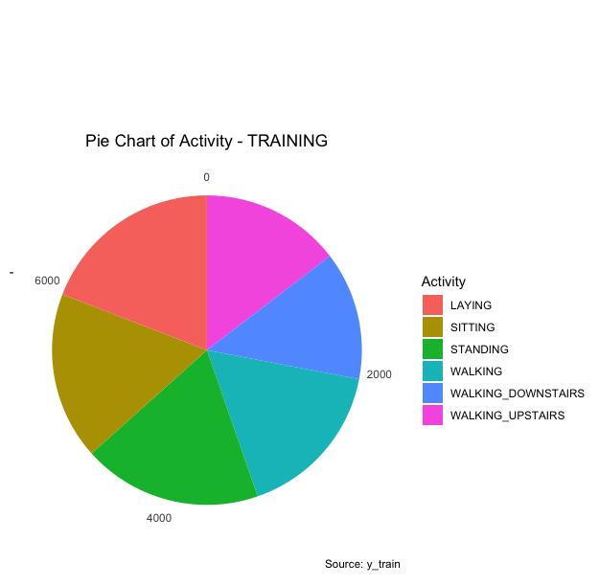
Data Visualization
Notes:
PIE CHART TO SHOW DISTRIBUTION OF ALL SIX ACTIVITIES IN TRAINING RESULTS

Slide 6
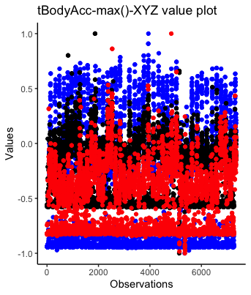
Notes:
To check tBodyAcc-max()-XYZ values are between -1 and +1

Slide 7
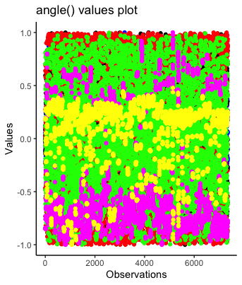
Notes:
To check all angle() values are between -1 and +1

Slide 8
Data Preprocessing
Dataset already splits by 70% training and 30% testing.
There is no null value.
Change column name in the training and testing label.
Check for redundant data: res_train <- cor(X_train)
Check for imbalance data: Histogram for frequencies.
No data transformation as the data are numeric
Because we use KNN, SVM and Random Forest for machine learning models, no standardization is needed as all features are in the same unit of coordination.

Slide 9
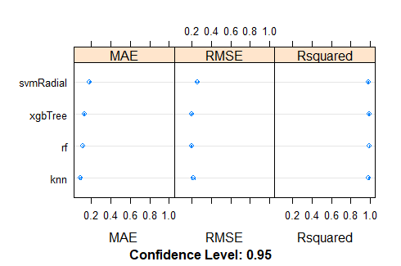
Ensemble
Notes:
Since this is a classification problem with multi-classes, I choose SVMRadial, XGBTree, Random Forest, and KNN as the 4 main classification models. The algorithm for ensemble is stacking method.
SVM Radial - Since we deal with angle XYZ and multiple values from 3-axial linear acceleration and 3-axial angular velocity. We thought it is possible this will work better than SVM Linear
XGBTree and Random Forest - With XGBTree, we want the model to run faster. With Random Forest, it has been one of the go-to models for most of our classification problems. I want to see which tree model is the best fit for my dataset.
KNN - Since we have many angles’ measurements, we think KNN will give us a high accuracy rate by calculating distances between them.
As expected, KNN is the best model, and second place is Random Forest because they have not much differences in RSquared, but MAE and RMSE is lower compared to the rest.
Based on Ensemble model, I decided to further exploring KNN, Random Forest, and SVM

Slide 10
Model
Model | Summary
KNN (k = 5, 10, 25) | 90.2%, 90.5%, 90.4%
Tuned SVMLinear | 96.1%
Tuned SVMPoly (Degree: 3-5) | Degree 5: 95.4%
RF (ntree= 100,200) | 90.4%, 91.9%
Neutral Network (2 hidden layers, 200 neurons each). epochs = 1000) | MSE: 0.012

